Slide 1
Unit 8
Support Vector Machines
EE-uy 4563/EL-GY 9143: Introduction to machine learning
Prof. Sundeep rangan, With Modification by Yao Wang

Slide 2
Learning Objectives
Interpret weights in linear classification of images
Describe why linear classification for images does not work
Define the margin in linear classification
Describe the SVM classification problem.
Write equations for solutions of constrained optimization using the Lagrangian.
Describe a kernel SVM problem for non-linear classification
Implement SVM classifiers in python
Select SVM parameters from cross-validation

Slide 3
Outline
Motivating example: Recognizing handwritten digits
  Why logistic regression doesn’t work well.
Maximum margin classifiers
Support vector machines
Kernel trick
Constrained optimization

Slide 4
MNIST Digit Classification
Problem: Recognize hand-written digits
Original problem:
  Census forms
  Automated processing
Classic machine learning problem
Benchmark
From Patrick J. Grother, NIST Special Database, 1995

Slide 5
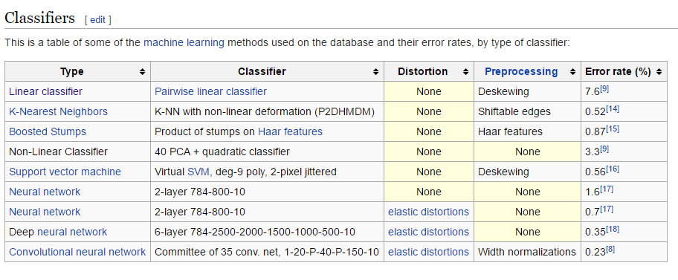
A Widely-Used Benchmark
We will look at SVM today
Not the best algorithm
But quite good
…and illustrates the main points

Slide 6
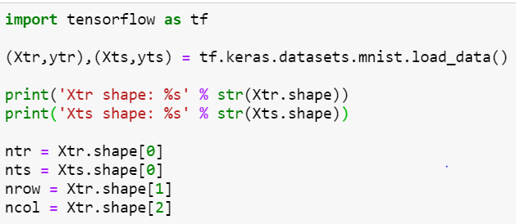

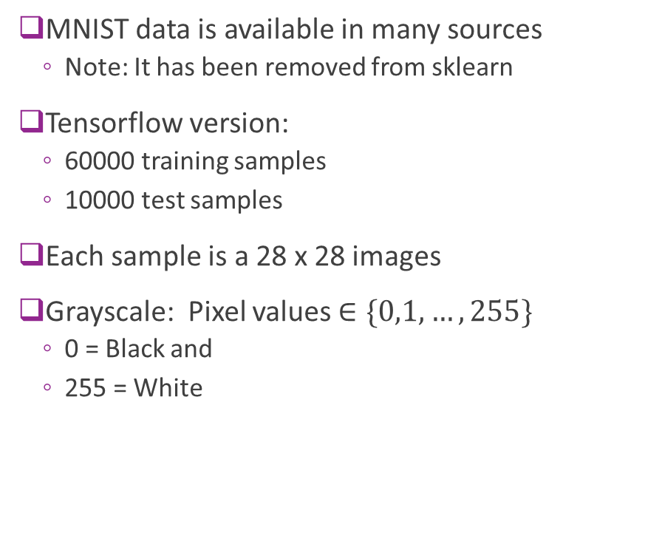
Downloading MNIST
MNIST data is available in many sources
  Note: It has been removed from sklearn
Tensorflow version:
  60000 training samples
  10000 test samples
Each sample is a 28 x 28 images
Grayscale: Pixel values $∈\{0,1,…,255\}$
  0 = Black and
  255 = White

Slide 7
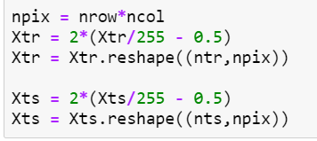

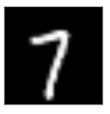


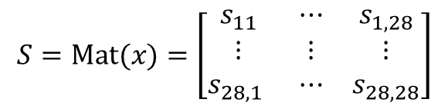


Matrix and Vector Representation
For this demo, we reshape data from $N×28×28$ to $N×784$
But, you can easily go back and forth
Also, scale the pixel values from -1 to 1
28
784 = ${28}^{2}$
28
xsq
$$S=\text{M}\text{at}(x)=\left[\begin{matrix}s_{11} & ⋯ & s_{1,28} \\ ⋮ & ⋮ & ⋮ \\ s_{28,1} & ⋯ & s_{28,28}\end{matrix}\right]$$
$$x=\text{v}\text{ec}(S)=\left[\begin{matrix}x_{1} & ⋯ & x_{784}\end{matrix}\right]$$

Slide 8
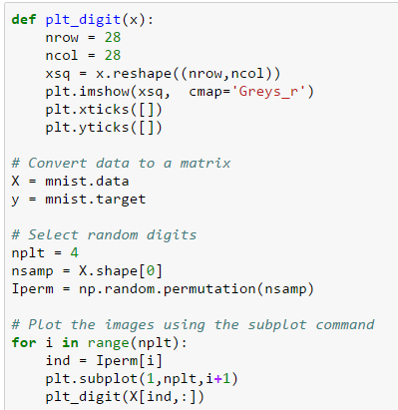
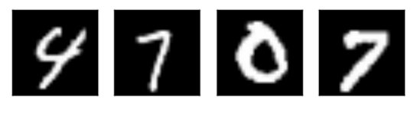
Displaying Images in Python
Key command
Sample permutation is necessary for this dataset, as the original data is ordered by digits
4 random images in the dataset
A human can classify these easily

Slide 9
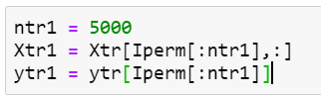
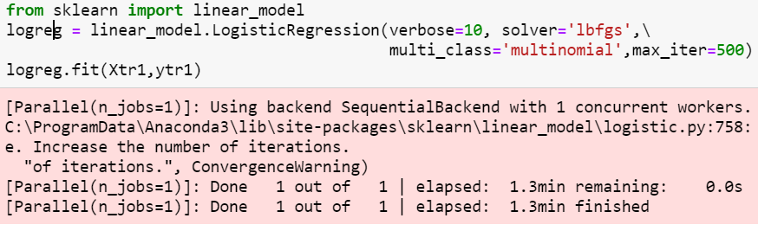
Try a Logistic Classifier
Train on 5000 samples
  To reduce training time.
  In practice want to train with ~40k
Select correct solver (lbfgs)
  Others can be very slow. Even this will take minutes

Slide 10
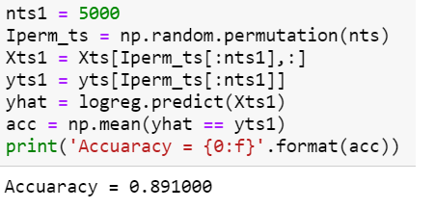
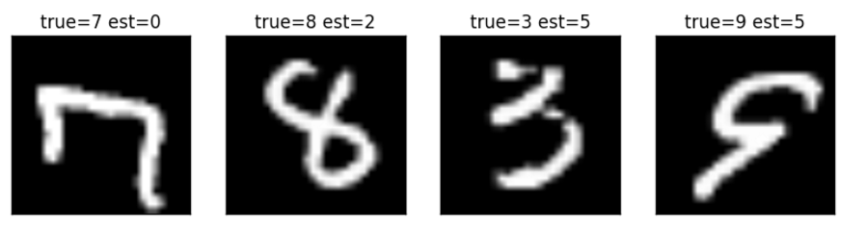
Performance
Accuracy = 89%. Very bad
Some of the errors seem like they should have been easy to spot
What went wrong?

Slide 11




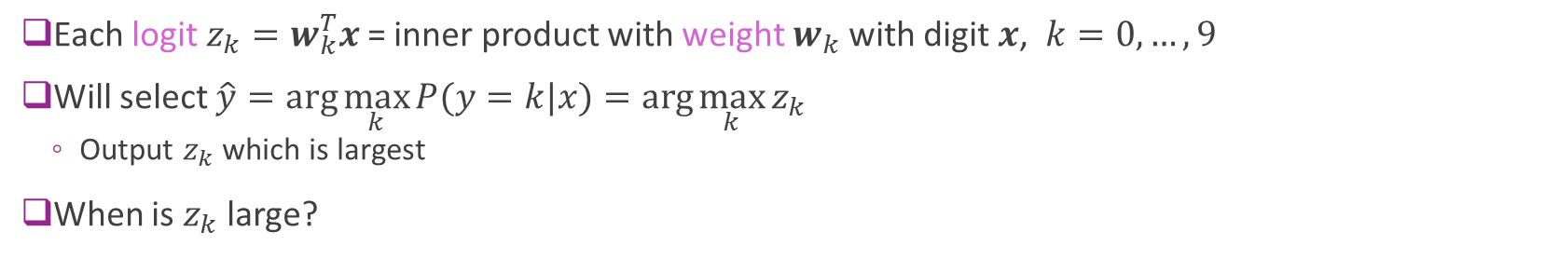
Recap: Logistic Classifier
Logits
Weights
$$x$$
Softmax
$$P(y=k|x)$$
10
$$w_{k}^{T}$$
$$z_{k}$$
Probabilities
Convert 28 x 28
to 784-dim vector
784
Each logit $z_{k}=w_{k}^{T}x$ = inner product with weight $w_{k}$ with digit $x$, $k=0,…,9$
Will select $\hat{y}=\arg{\max_{k}{P(y=k|x)}}=\arg{\max_{k}{z_{k}}}$
  Output $z_{k}$ which is largest
When is $z_{k}$ large?

Slide 12
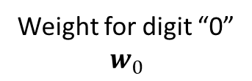
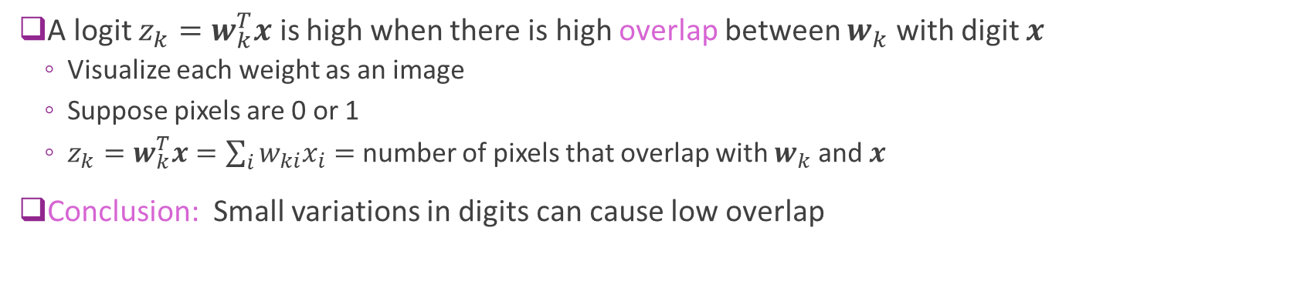

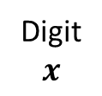

Interpreting the Logistic Classifier Weights
A logit $z_{k}=w_{k}^{T}x$ is high when there is high overlap between $w_{k}$ with digit $x$
  Visualize each weight as an image
  Suppose pixels are 0 or 1
  $z_{k}=w_{k}^{T}x=\sum_{i}{w_{ki}x_{i}}=$ number of pixels that overlap with $w_{k}$ and $x$
Conclusion: Small variations in digits can cause low overlap
Weight for digit “0”
$$w_{0}$$
Digit
$$x$$
Overlap high $⇒x$ is digit 0
Overlap low $⇒x$ not digit 0

Slide 13
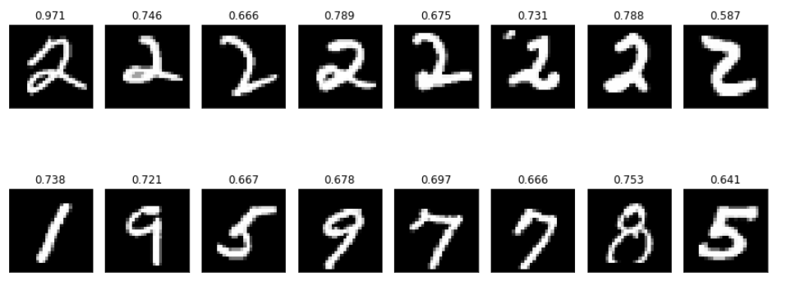
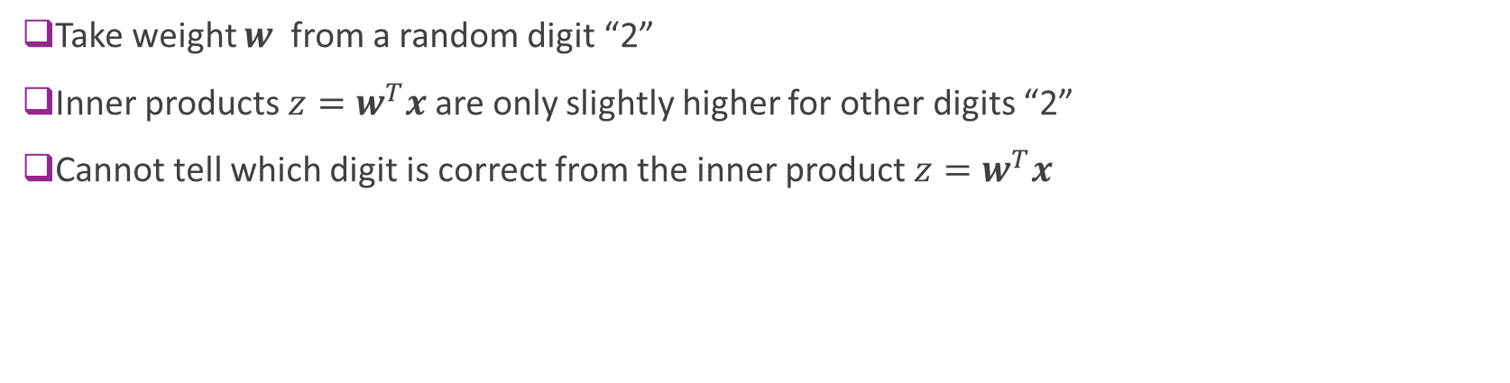



Example with Actual Digits
Take weight $w$ from a random digit “2”
Inner products $z=w^{T}x$ are only slightly higher for other digits “2”
Cannot tell which digit is correct from the inner product $z=w^{T}x$
Digits $x$
$z=w^{T}x$
Weight $w$

Slide 14
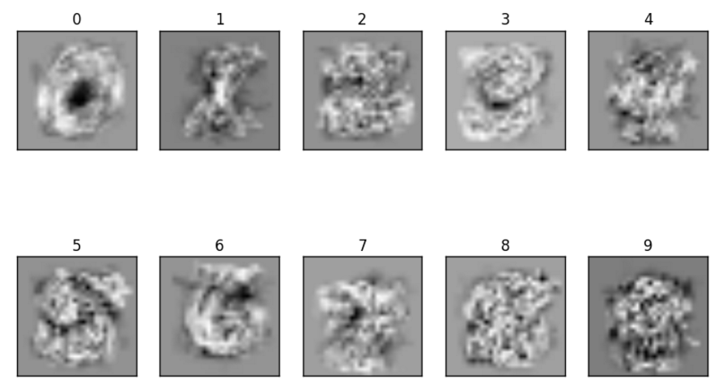
Visualizing the Weights
Optimized weights of the classifier
Blurry versions of image to try to capture rotations, translations, …

Slide 15
Problems with Logistic Classifier
Linear weighting cannot capture many deformities in image
  Rotations
  Translations
  Variations in relative size of digit components
Can be improved with preprocessing
  E.g. deskewing, contrast normalization, many methods
Is there a better classifier?

Slide 16
Outline
Motivating example: Recognizing handwritten digits
  Why logistic regression doesn’t work well.
Maximum margin classifiers
Support vector machines
Kernel trick
Constrained optimization

Slide 17
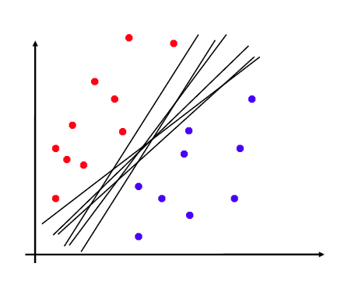
Non-Uniqueness of Separating Plane
Linearly separable data:
  Can find a separating hyper-plane as a linear classifier.
Separating hyper-plane is not unique
  Fig. on right: Many separating planes
Which one is optimal?

Slide 18
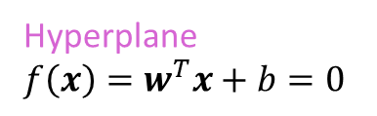
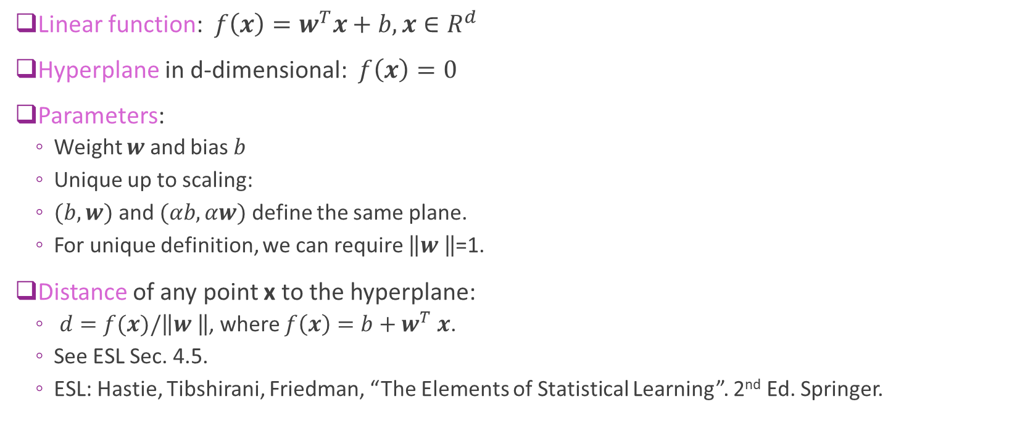


Hyperplane Basics
Linear function: $f\left(x\right)=w^{T}x+b,x∈R^{d}$
Hyperplane in d-dimensional: $f\left(x\right)=0$
Parameters:
  Weight $w$ and bias $b$
  Unique up to scaling:
  $(b,w)$ and $(αb,αw)$ define the same plane.
  For unique definition, we can require $\left\|w \right\|$=1.
Distance of any point x to the hyperplane:
  $d=f(x)/\left\|w \right\|$, where $f\left(x\right)=b+w^{T}$ $x$.
  See ESL Sec. 4.5.
  ESL: Hastie, Tibshirani, Friedman, “The Elements of Statistical Learning”. 2nd Ed. Springer.
$$f\left(x\right)$$
$$d=\frac{f\left(x\right)}{\left\|w \right\|}$$
Hyperplane
$f\left(x\right)=w^{T}x+b=0$

Slide 19
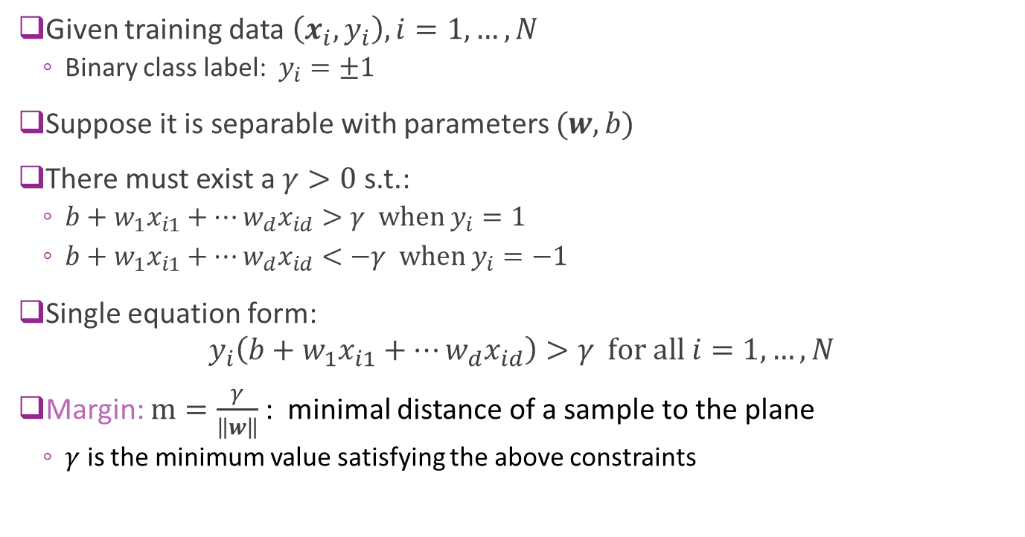


Linear Separability and Margin
Given training data $\left(x_{i},y_{i}\right), i=1,…,N$
  Binary class label: $y_{i}=±1$
Suppose it is separable with parameters $(w,b)$
There must exist a $γ>0$s.t.:
  $b+w_{1}x_{i1}+⋯w_{d}x_{id}>γ \text{when} y_{i}=1$
  $b+w_{1}x_{i1}+⋯w_{d}x_{id}<−γ \text{when} y_{i}=−1$
Single equation form:
$$y_{i}\left(b+w_{1}x_{i1}+⋯w_{d}x_{id}\right)>γ \text{for} \text{all} i=1,…,N$$
Margin: $m=\frac{γ}{\left\|w\right\|}$: minimal distance of a sample to the plane
  $γ$ is the minimum value satisfying the above constraints
$$m$$
$$m$$

Slide 20
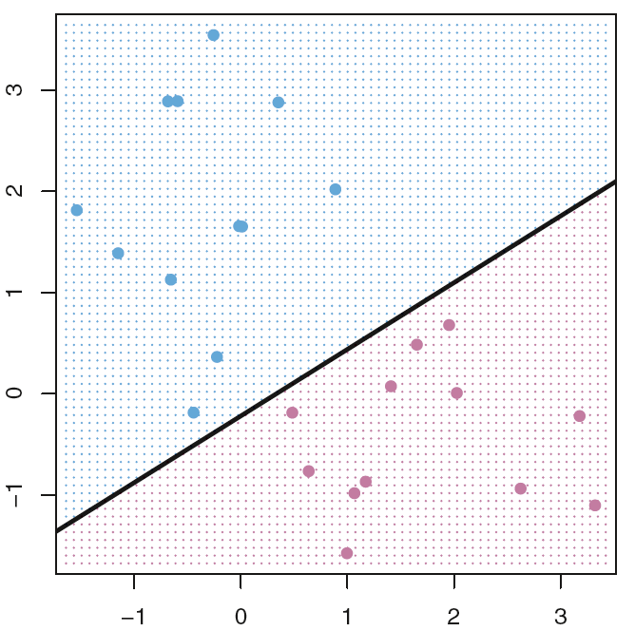
Which separating plane is better ?
From Fig. 9.2 and Fig. 9.3 in ISL.

Slide 21
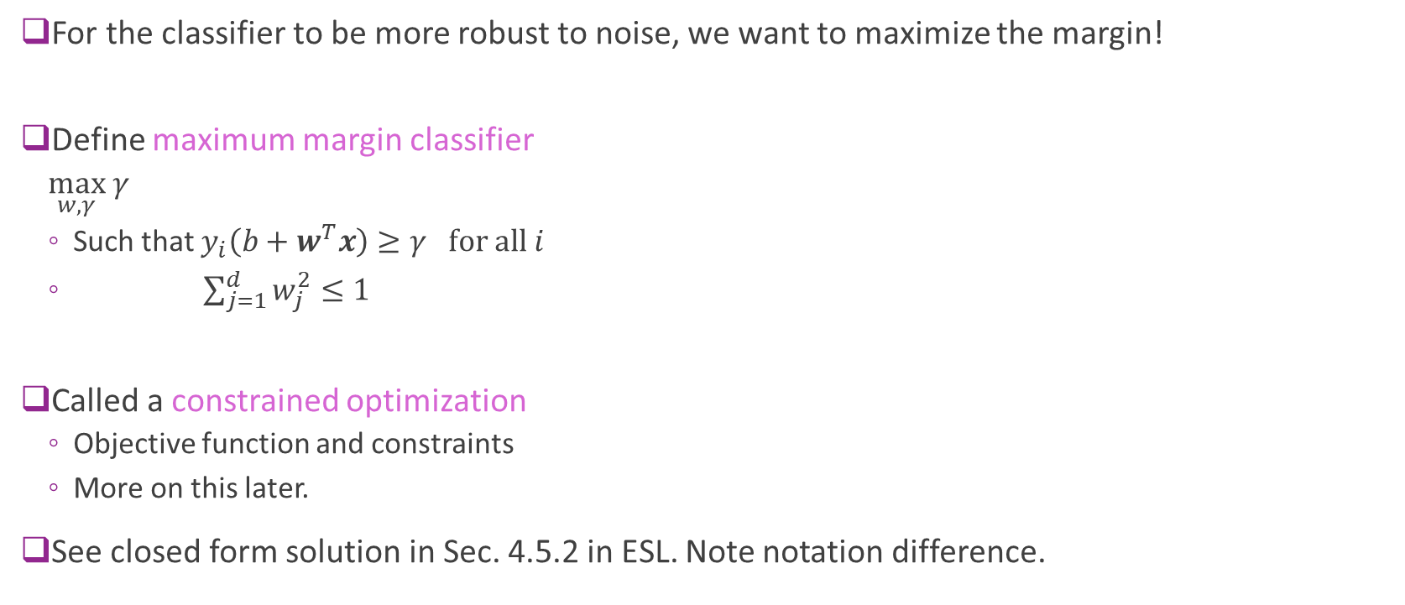
Maximum Margin Classifier
For the classifier to be more robust to noise, we want to maximize the margin!
Define maximum margin classifier
  $\max_{w, γ} γ$
  Such that $y_{i}\left(b+w^{T}x\right)≥γ \text{for} \text{all} i$
  $\sum_{j=1}^{d}{w_{j}^{2}}≤1$
Called a constrained optimization
  Objective function and constraints
  More on this later.
See closed form solution in Sec. 4.5.2 in ESL. Note notation difference.
Maximizes the margin
Ensures all points are correctly classified
Scaling on weights

Slide 22
Visualizing Maximum Margin Classifier
Fig. 9.3 of ISL
Margin determined by closest points to the line
  The maximal margin hyperplane represents the mid-line of the widest “slab” that we can insert between two classes
In this figure, there are 3 points at the margin
ISL: James, Witten, Hastie, Tibshirani, An Introduction to Statistical Learning, Springer. 2013.

Slide 23
Problems with MM classifier
Data is often not perfectly separable
  Only want to correctly separate most points
MM classifier is not robust
  A single sample can radically change line
Fig. 9.4
Fig. 9.5

Slide 24
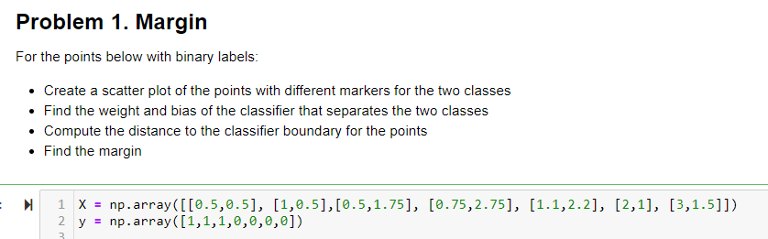
In-Class Exercise
Found in github site: svm_inclass.ipynb

Slide 25
Outline
Motivating example: Recognizing handwritten digits
  Why logistic regression doesn’t work well.
Maximum margin classifiers
Support vector machines
Kernel trick
Constrained optimization

Slide 26
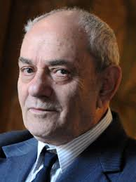
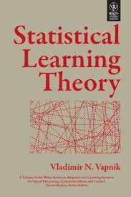
Support Vector Machine
Support Vector Machine (SVM)
  Vladimir Vapnik, 1963
  But became widely-used with kernel trick, 1993
  More on this later
Got best results on character recognition
Key idea: Allow “slack” in the classification
  Support vector classifier (SVC): Directly use raw features. Good when the original feature space is roughly linearly separable
  Support vector machine (SVM): Map the raw features to some other domain through a kernel function

Slide 27
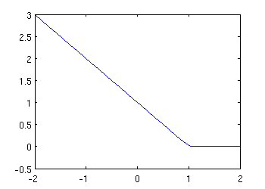
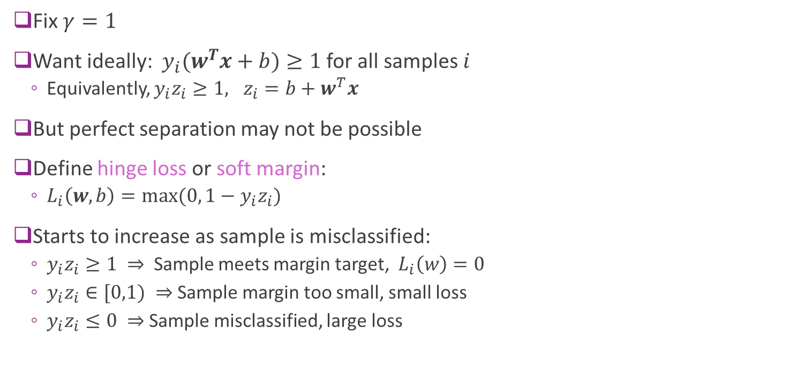


Hinge Loss
Fix $γ=1$
Want ideally: $y_{i}(w^{T}x+b)≥1$ for all samples $i$
  Equivalently, $y_{i}z_{i}≥1, z_{i}=b+w^{T}x$
But perfect separation may not be possible
Define hinge loss or soft margin:
  $L_{i}\left(w,b\right)=max⁡(0, 1−y_{i}z_{i})$
Starts to increase as sample is misclassified:
  $y_{i}z_{i}≥1 ⇒$ Sample meets margin target, $L_{i}\left(w\right)=0$
  $y_{i}z_{i}∈[0,1) ⇒$Sample margin too small, small loss
  $y_{i}z_{i}≤0 ⇒$Sample misclassified, large loss
$$L_{i}(z_{i})$$
$${y_{i}z}_{i}$$
Misclassifies
Meets margin
Close to
margin

Slide 28
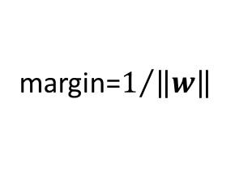
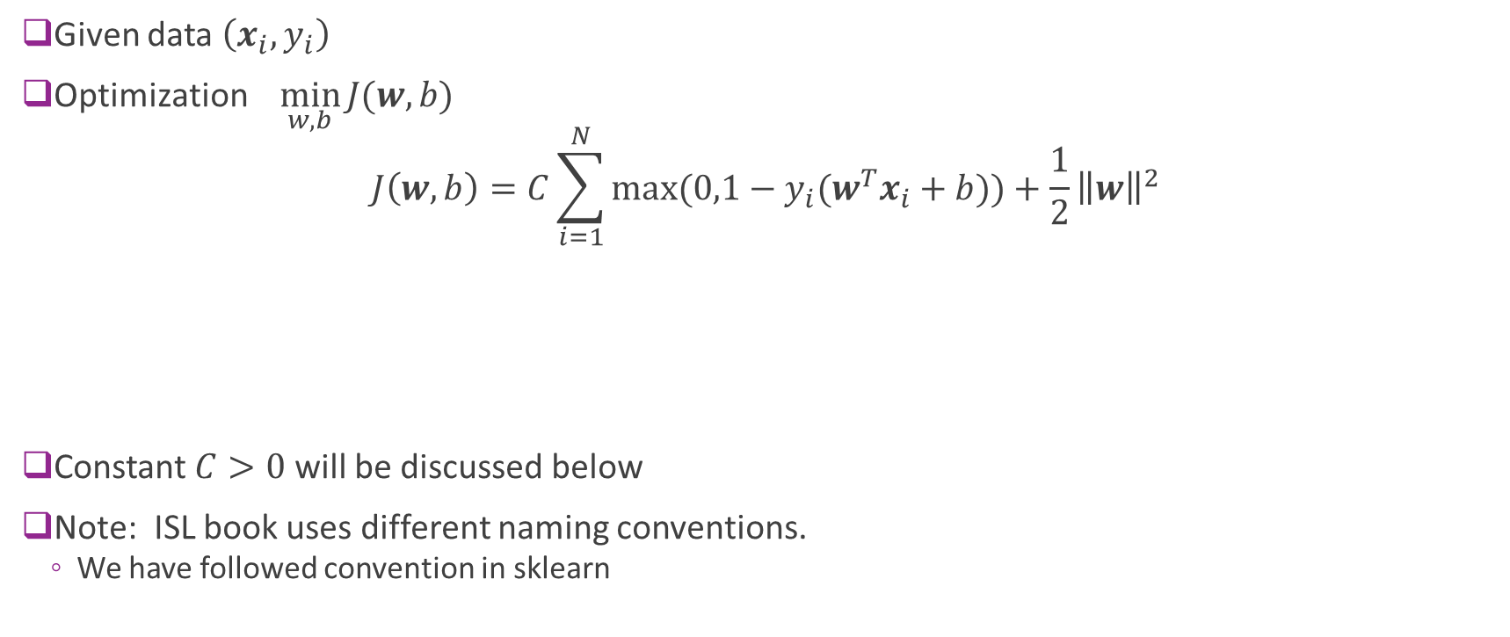
SVM Optimization
Given data $\left(x_{i},y_{i}\right)$
Optimization $\min_{w,b}{J(w,b)}$
$$J\left(w,b\right)=C\sum_{i=1}^{N}{max⁡(0,1−y_{i}(w^{T}x_{i}+b))}+\frac{1}{2}{\left\|w\right\|}^{2}$$
Constant $C>0$ will be discussed below
Note: ISL book uses different naming conventions.
  We have followed convention in sklearn
C controls final margin
Hinge loss term
Attempts to reduce
Misclassifications
margin=$1/{\left\|w\right\|}$

Slide 29
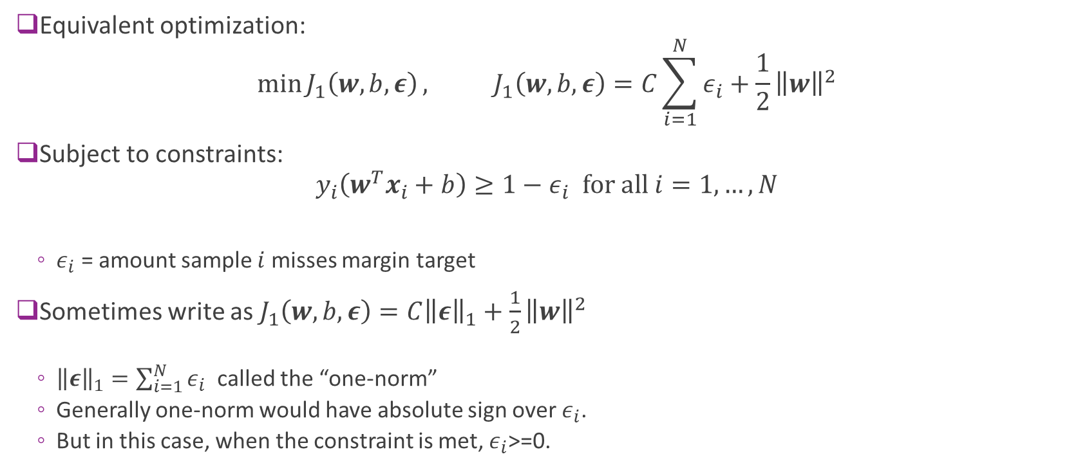
Alternate Form of SVM Optimization
Equivalent optimization:
$$\min{J_{1}\left(w,b,ε\right)}, J_{1}\left(w,b,ε\right)=C\sum_{i=1}^{N}{ε_{i}}+\frac{1}{2}{\left\|w\right\|}^{2}$$
Subject to constraints:
$${y_{i}\left(w^{T}x_{i}+b\right)≥1−ε}_{i} for all i=1,…,N$$
  $ε_{i}$ = amount sample $i$ misses margin target
Sometimes write as $J_{1}\left(w,b,ε\right)=C{\left\|ε\right\|}_{1}+\frac{1}{2}{\left\|w\right\|}^{2}$
  ${\left\|ε\right\|}_{1}=\sum_{i=1}^{N}{ε_{i}}$ called the “one-norm”
  Generally one-norm would have absolute sign over $ε_{i}$.
  But in this case, when the constraint is met, $ε_{i}$>=0.

Slide 30
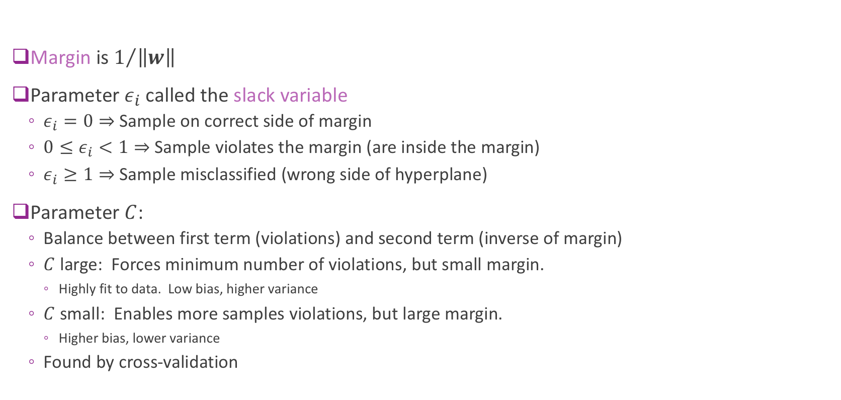
Interpreting Parameters
Margin is $1/{\left\|w\right\|}$
Parameter $ε_{i}$ called the slack variable
  $ε_{i}=0⇒$ Sample on correct side of margin
  ${0≤ε}_{i}<1⇒$ Sample violates the margin (are inside the margin)
  $ε_{i}≥1⇒$ Sample misclassified (wrong side of hyperplane)
Parameter $C$:
  Balance between first term (violations) and second term (inverse of margin)
  $C$ large: Forces minimum number of violations, but small margin.
    Highly fit to data. Low bias, higher variance
  $C$ small: Enables more samples violations, but large margin.
    Higher bias, lower variance
  Found by cross-validation

Slide 31
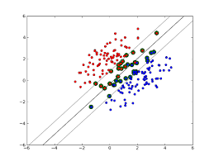

Support Vectors
Support vectors: Samples that either:
  Are exactly on margin: $y_{i}(w^{T}x_{i}+b)=1$
  Or, on wrong side of margin: $y_{i}\left(w^{T}x_{i}+b\right)≤1$
Changing samples that are not SVs
  Does not change solution
  Provides robustness

Slide 32

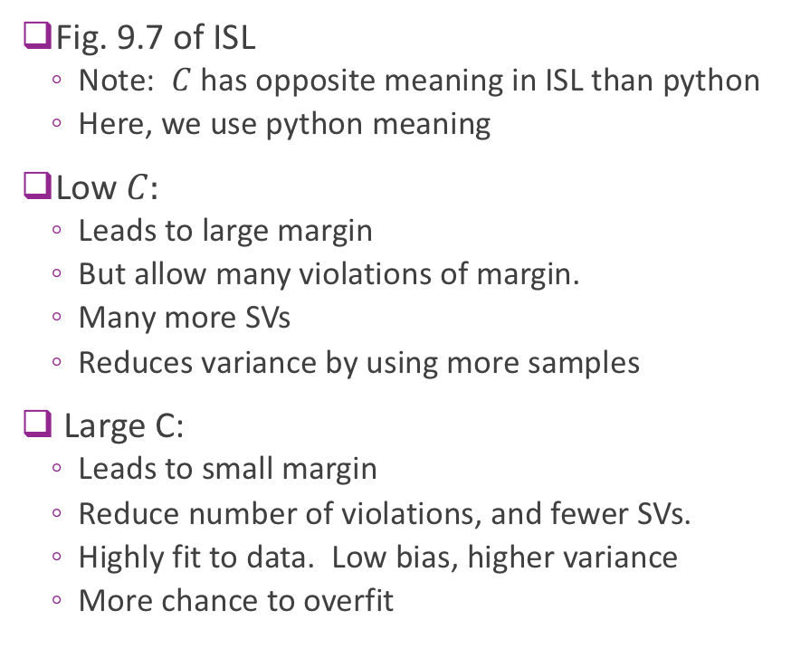




Illustrating Effect of $C$
Low $C=C_{1}$
$$C_{2}$$
Fig. 9.7 of ISL
  Note: $C$ has opposite meaning in ISL than python
  Here, we use python meaning
Low $C:$
  Leads to large margin
  But allow many violations of margin.
  Many more SVs
  Reduces variance by using more samples
Large C:
  Leads to small margin
  Reduce number of violations, and fewer SVs.
  Highly fit to data. Low bias, higher variance
  More chance to overfit
$$C_{3}$$
High $C_{4}$

Slide 33
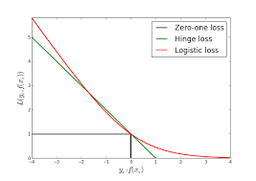
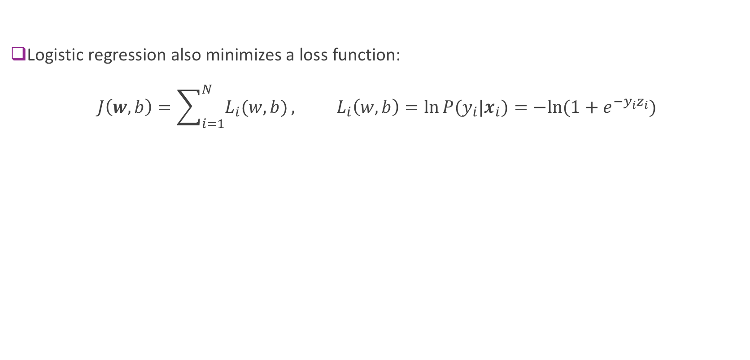
Relation to Logistic Regression
Logistic regression also minimizes a loss function:
$J\left(w,b\right)=\sum_{i=1}^{N}{L_{i}(w,b)}, L_{i}\left(w,b\right)=\ln{P(y_{i}|x_{i})}=−ln⁡(1+e^{−{y_{i}z}_{i}})$

Slide 34
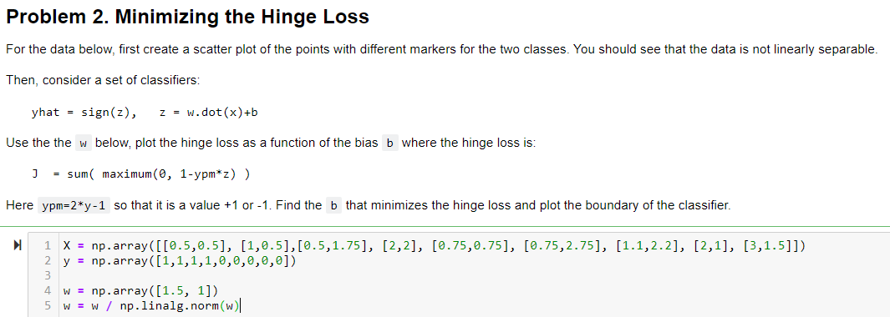
In-Class Exercise

Slide 35
Outline
Motivating example: Recognizing handwritten digits
  Why logistic regression doesn’t work well.
Maximum margin classifiers
Support vector machines
Kernel trick
Constrained optimization

Slide 36
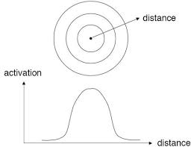
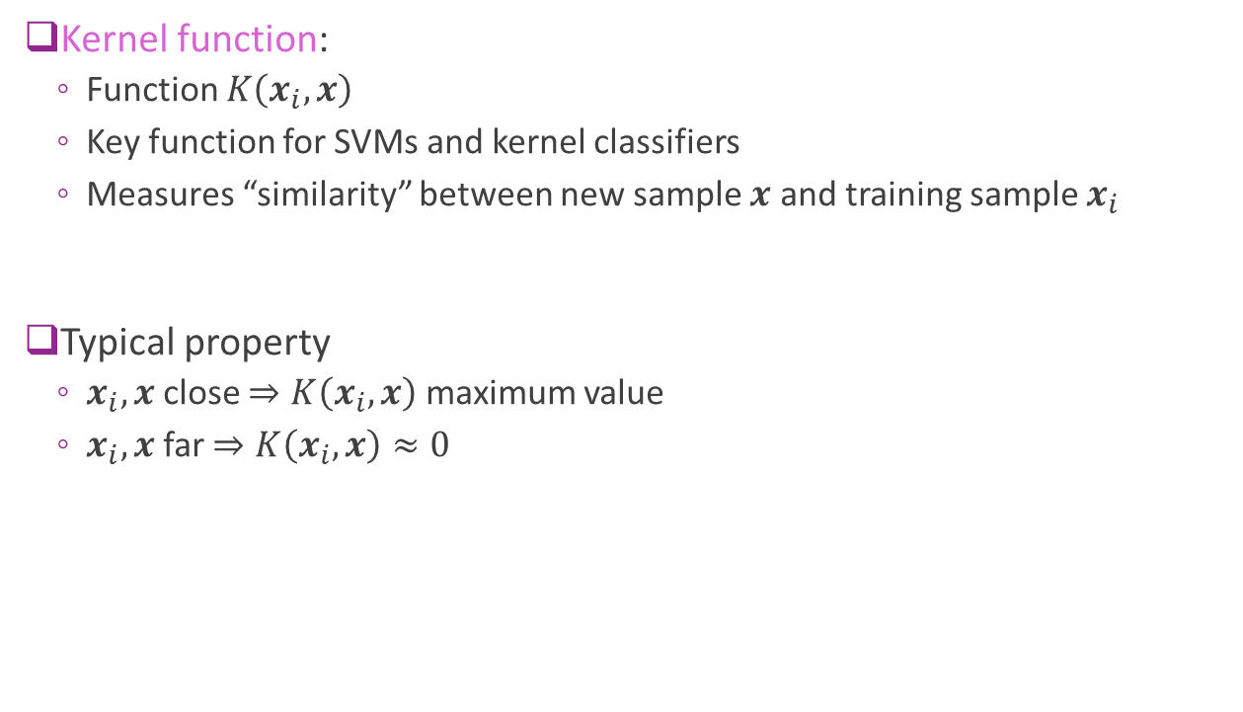
The Kernel Function
Kernel function:
  Function $K\left(x_{i},x\right)$
  Key function for SVMs and kernel classifiers
  Measures “similarity” between new sample $x$ and training sample $x_{i}$
Typical property
  $x_{i},x$ close $⇒K\left(x_{i},x\right)$ maximum value
  $x_{i},x$ far $⇒K\left(x_{i},x\right)≈0$

Slide 37
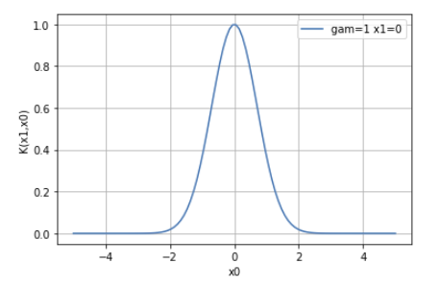

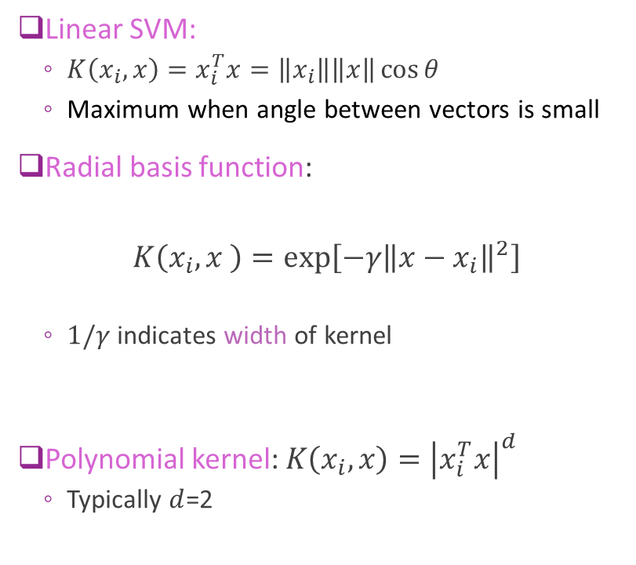


Common Kernels
Linear SVM:
  $K\left(x_{i},x\right)=x_{i}^{T}x=\left\|x_{i}\right\|\left\|x\right\|\cos{θ}$
  Maximum when angle between vectors is small
Radial basis function:
$$K\left(x_{i},x \right)=\exp\left[−γ{\left\|x−x_{i}\right\|}^{2}\right]$$
  $1/γ$ indicates width of kernel
Polynomial kernel: $K\left(x_{i},x\right)={\left|x_{i}^{T}x\right|}^{d}$
  Typically $d$=2
$$x_{i}$$
$$θ$$
$$x$$

Slide 38
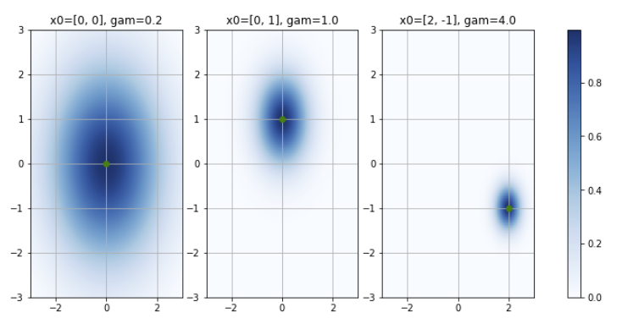
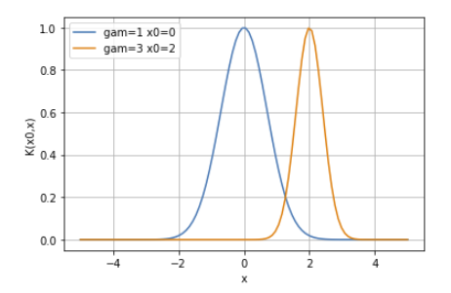
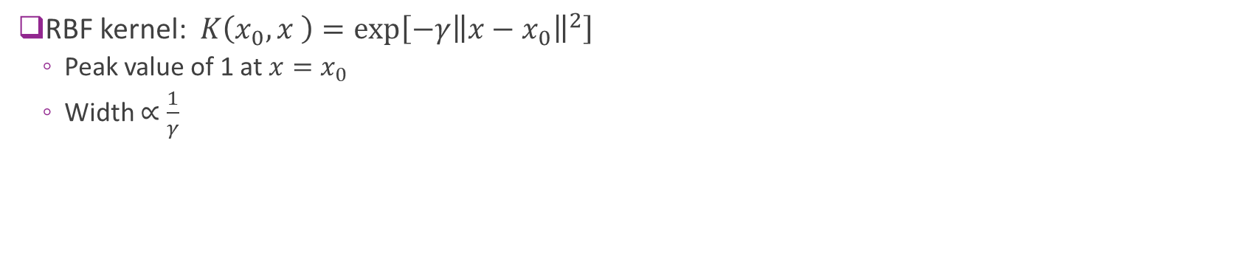
RBF Kernel Examples
RBF kernel: $K\left(x_{0},x \right)=\exp\left[−γ{\left\|x−x_{0}\right\|}^{2}\right]$
  Peak value of 1 at $x=x_{0}$
  Width $∝\frac{1}{γ}$
RBFs in 1D
RBFs in 2D

Slide 39
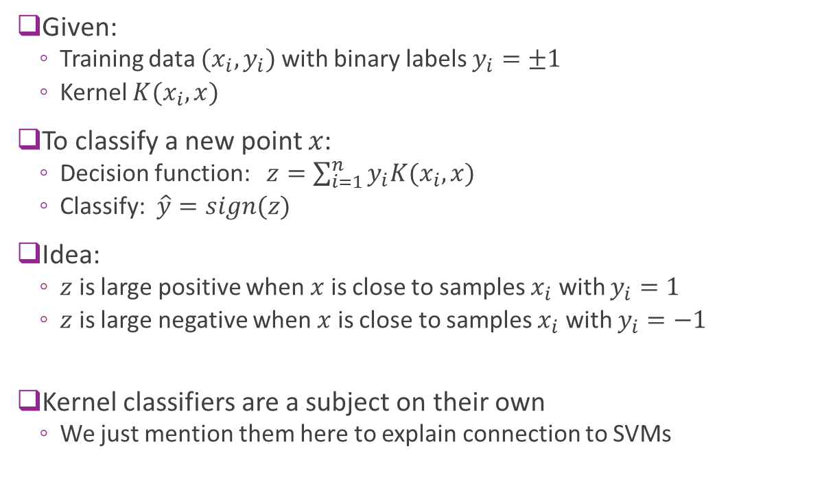
Kernel Classifier
Given:
  Training data $(x_{i},y_{i})$ with binary labels $y_{i}=±1$
  Kernel $K(x_{i},x)$
To classify a new point $x$:
  Decision function: $z=\sum_{i=1}^{n}{y_{i}K(x_{i},x)}$
  Classify: $\hat{y}=sign(z)$
Idea:
  $z$ is large positive when $x$ is close to samples $x_{i}$ with $y_{i}=1$
  $z$ is large negative when $x$ is close to samples $x_{i}$ with $y_{i}=−1$
Kernel classifiers are a subject on their own
  We just mention them here to explain connection to SVMs

Slide 40



Example in 1D
Example data with 6 points $(x_{i},y_{i})$
  RBF kernel: $K\left(x_{i},x\right)=e^{−γ{\left(x_{i}−x\right)}^{2}}, γ=1$
Decision function:
  $z=\sum_{i=1}^{n}{y_{i}K(x_{i},x)}$
  Sum of bell curves
  Positive when near positive samples
  Negative when near negative samples
Classification:
  $\hat{y}=sign(z)$
$$i$$ | 1 | 2 | 3 | 4 | 5 | 6
$$x_{i}$$ | -1 | 0 | 1 | 2 | 3 | 5
$$y_{i}$$ | -1 | -1 | 1 | -1 | 1 | 1

Slide 41


Effect of Gamma
Same data as before
RBF kernel: $K\left(x_{i},x\right)=e^{−γ{\left(x_{i}−x\right)}^{2}}$
As $γ$ increases:
  Decision function $z≈y_{i}$ when $x=x_{i}$
  Classifier fits training data better
  Classification region more complex
As a classifier, higher $γ$results in:
  Lower bias error
  But, higher variance error

Slide 42


SVMs with Non-Linear Transformations
Non-linear transformation:
  Replace $x$ with $φ\left(x\right)$
  Enables more rich, non-linear classifiers
  Examples: polynomial classification
  $φ\left(x\right)=[1,x,x^{2},…,x^{d−1}]$
Tries to find separation in a feature space
Kernel trick in SVMs:
  Makes applying non-linear transformations easy

Slide 43


SVM with the Transformation
Consider SVM model with $x$ replaced by $φ(x)$
Minimize SVM cost function as before (i.e. Hinge loss + inverse margin)
Theorem: The optimal weight is of the form:
  $$w=\sum_{i=1}^{N}{α_{i}y_{i}φ(x_{i})}$$
  $α_{i}≥0$ for all $i$
  $α_{i}>0$ if and only if sample $i$ is a support vector
  Will show this fact later using results in constrained optimization
Consequence: The linear discriminant on any other sample $x$ is:
  $$z=b+w^{T}φ(x)=b+\sum_{i=1}^{N}{α_{i}y_{i} φ{\left(x_{i}\right)}^{T}φ(x)}$$
$K(x_{i},x)$ = “kernel”

Slide 44

Kernel Form of the SVM Classifier
SVM classifier can be written with the kernel $K\left(x_{i},x\right)$ and values $α_{i}≥0$:
  $$z=b+\sum_{i=1}^{N}{α_{i}y_{i}K\left(x_{i},x\right)},$$
  $$\hat{y}=\text{sign}\left(z\right)=\left\{\begin{matrix}1 & \text{if} z>0 \\ −1 & \text{if} z<0\end{matrix}\right.$$
Key point: SVM classifier is approximately Kernel classifier
But there are two differences:
  Weights $α_{i}≥0$ on the samples (the weights are only non-zero on the SVs)
  A bias term $b$ (can be positive or negative)
Decision function
Classification decision

Slide 45

“Kernel Trick” and Dual Parameterization
Kernel form of SVM classifier (previous slide):
  $$z=b+\sum_{i=1}^{N}{α_{i}y_{i}K\left(x_{i},x\right)}, \\ \hat{y}=\text{sign}\left(z\right)$$
Dual parameters: $α_{i}≥0,i=1,…,N$
  Called the dual parameters due to constrained optimization – see next section
Kernel trick:
  Directly solve the parameters $α$ instead of the weights $w$
  Can show that the optimization only needs the kernel $K\left(x_{i},x\right)$
  Does not need to explicitly use $φ(x)$

Slide 46



SVM Example in 1D
Same data as in the Kernel classifier example
Fit SVM with RBF with different $γ$
Similar trends as kernel classifier: As $γ$ increases
  $z$“fits” data $(x_{i},y_{i})$ closer
  Leads to more complex decision regions.
  Enables nonlinear decision regions
$$i$$ | 1 | 2 | 3 | 4 | 5 | 6
$$x_{i}$$ | -1 | 0 | 1 | 2 | 3 | 5
$$y_{i}$$ | -1 | -1 | 1 | -1 | 1 | 1

Slide 47


Example in 2D
Decision function
Classification
Example:
  10 data points with binary labels
  Fit SVM with $C=1$ and RBF
  $γ=$ 0.3, 3 and 10
Plot:
  $z$= linear discriminant
  $\hat{y}=sign\left(z\right)=$ classification decision
Observe: As $γ$ increases
  Fits training data better
  More complex decision region

Slide 48


Parameter Selection
For SVMs with RBFs we need to select:
  Parameter $C>0$ in the loss function
  Kernel width $γ>0$
Higher $C$ or $γ$
  Fewer SVs
  Classifiers averages over smaller set
  Lower bias, but higher variance
Typically select via cross-validation
  Try out different $(C,$ $γ)$ pairs
  Find which one provides highest accuracy on test set
Python can automatically do grid search
http://peekaboo-vision.blogspot.com/2010/09/mnist-for-ever.html

Slide 49

Multi-Class SVMs
Suppose there are $K$ classes
One-vs-one:
  Train $\left(\begin{matrix}K \\ 2\end{matrix}\right)$ SVMs for each pair of classes
  Test sample assigned to class that wins “majority of votes”
  Best results but very slow
One-vs-rest:
  Train $K$ SVMs: train each class $k$ against all other classes
  Pick class with highest $z_{k}$
Sklearn has both options

Slide 50





MNIST Results
Run classifier
Very slow
  Several minutes for 40,000 samples
  Slow in training and test
  Major drawback of SVM
Accuracy $≈0.984$
  Much better than logistic regression
Can get better with:
  pre-processing
  More training data
  Optimal parameter selection

Slide 51

MNIST Errors
Some of the error are hard even for a human

Slide 52
Outline
Motivating example: Recognizing handwritten digits
  Why logistic regression doesn’t work well.
Maximum margin classifiers
Support vector machines
Kernel trick
Constrained optimization

Slide 53

Constrained Optimization
In many problems, variables are constrained
Constrained optimization formulation:
  Objective: Minimize $f(w)$
  Constraints: $g_{1}\left(w\right)≤0,…,g_{M}\left(w\right)≤0$
Examples:
  Minimize the mpg of a car subject to a cost or meeting some performance
  In ML: weight vector may have constraints from physical knowledge
Often write constraints in vector form: Write $g\left(w\right)≤0$
$g\left(w\right)={\left[g_{1}\left(w\right),…,g_{m}\left(w\right)\right]}^{T}$

Slide 54

Lagrangian
Constrained optimization: Min $f\left(w\right) \text{s}\text{.}\text{t}\text{.} g\left(w\right)≤0$
Consider first a single constraint: $g\left(w\right)$ is a scalar
Define Lagrangian: $L\left(w,λ\right)=f\left(w\right)+λg\left(w\right)$
  $w$ is called the primal variable
  $λ$ is called the dual variable
Dual minimization: Given a dual parameter $λ$, minimize
$\hat{w}\left(λ\right)=\arg{\min_{w}{L(w,λ)}}, L^{∗}\left(λ\right)=\min_{w}{L(w,λ)}$
  Minimizes a weighted combination of objective and constraint.
  Higher $λ⇒$ Weight constraint more (try to make $g\left(w\right)$ smaller)
  Lower $λ⇒$ Weight objective more (try to make $f\left(w\right)$ smaller)

Slide 55

KKT Conditions
Given objective $f\left(w\right)$ and constraint $g(w)$
KKT Conditions: $\hat{w},\hat{λ}$ satisfy:
  $\hat{w}$ minimizes the Lagrangian: $\hat{w}=\arg{\min_{w}{L(w,\hat{λ})}}$
  Either
    $g\left(\hat{w}\right)=0$ and $\hat{λ}≥0$ [active constraint]
    $g\left(\hat{w}\right)<0$ and $\hat{λ}=0$ [inactive constraint]
Theorem: Under some technical conditions,
  if $\hat{w},\hat{λ}$ are local mimima of the constrained optimization, they must satisfy KKT conditions

Slide 56

General Procedure for Single Constraint
Suppose:
  $w={\left(w_{1},…,w_{d}\right)}^{T}$: $d$ unknown primal variables
  $g\left(w\right)≤0$: scalar constraint
Case 1: Assume constraint is active:
  Solve $w$ and $λ$: ${∂L(w,λ)}/{∂w_{j}}=0$ and $g\left(w\right)=0$ (resulting from setting ${∂L(w,λ)}/{∂λ}=0$)
  $d+1$ unknowns and $d+1$ equations
  Verify that $λ≥0$
Case 2: Assume constraint is inactive
  Solve primal objective ${∂f(w)}/{∂w_{j}}=0$ ignoring constraint
  $d$ unknowns and $d$ equations
  Verify that constraint is satisfied: $g\left(w\right)≤ 0$

Slide 57

KKT Conditions Illustrated
Example 1: Constraint is “active”
$\min_{w}{w^{2}} s.t. w+1≤0$
Example 2: Constraint is “inactive”
$\min_{w}{w^{2}} s.t. w−1≤0$
Examples worked on board with illustration

Slide 58

Multiple Constraints
Now consider constraint: $g\left(w\right)={\left[g_{1}\left(w\right),…,g_{M}\left(w\right)\right]}^{T}≤0$.
Lagrangian is:
$L\left(w,λ\right)=f\left(w\right)+λ^{T}g\left(w\right)=f\left(w\right)+\sum_{m=1}^{M}{λ_{m}}g_{m}\left(w\right)$
  Weighted sum of all $M$ constraints
  $λ$ is called the dual vector
KKT conditions extend to:
  $\hat{w}$ minimizes the Lagrangian: $\hat{w}=\arg{\min_{w}{L(w,\hat{λ})}}$
  For each $m=1,…, M$
    $g_{m}\left(\hat{w}\right)=0$ and ${\hat{λ}}_{m}≥0$ [active constraint]
    $g_{m}\left(\hat{w}\right)<0$ and ${\hat{λ}}_{m}=0$ [inactive constraint]

Slide 59

SVM Constrained Optimization
Recall: SVM constrained optimization
$\min{J_{1}\left(w,b,ε\right)}, J_{1}\left(w,b,ε\right)=C\sum_{i=1}^{N}{ε_{i}}+\frac{1}{2}{\left\|w\right\|}^{2}$
  Constraints: ${y_{i}\left(w^{T}x_{i}+b\right)≥1−ε}_{i} and ε_{i}≥0 for all i=1,…,N$
After applying KKT conditions and some algebra [beyond this class], solution is
  Optimal weight vector: $w=\sum_{i=1}^{N}{α_{i}y_{i}x_{i}}$ linear combination of instances
  Dual parameters $α_{i}$ minimize
  $\sum_{i=1}^{N}{α_{i}}+\frac{1}{2}\sum_{i=1}^{N}{\sum_{j=1}^{N}{α_{i}α_{j}y_{i}y_{j}x_{i}^{T}x_{j}}} s.t. 0≤α_{i}≤C$

Slide 60

Support Vectors
Classifier weight is: $w=\sum_{i=1}^{N}{α_{i}y_{i}x_{i}}$
Can show that $α_{i}>0$ only when $x_{i}$ is a support vector
  On boundary or violating constraint
  Otherwise $α_{i}=0$

Slide 61
What you should know
Interpret weights in linear classification of images (logistic regression): Match filters
Understand the margin in linear classification and maximum margin classifier
SVM classifier: Allow violation of margin by introducing slack variables (More robust than linear classifier)
Solve constrained optimization using the Lagrangian.
  Understand KKT conditions for a single constraint
Extend to nonlinear classifier by feature transformation: SVM with nonlinear kernels
Select SVM parameters from cross-validation

